Slide 1


Not Only Fair Play – October 2016
Notes:
Good morning. Erasmus+ and other European projects provide a multitude of benefits and learning opportunities for all types of organisations – from the large educational establishments to smaller business owners who can indirectly benefit. All projects have their core aims in mind; their outputs, their outcomes; their key performance indicators; their impacts and many more. Today you are going to hear about the Not Only Fair Play project and I am sure you will hear about the strong benefits that this project has brought to partners, associate partners, policy makers and many other influential actors in trying to bring sports to the forefront of our learning opportunities.
I however, would like to go off on a different angle. We are in Scotland after all, and we tend to not go along with what our friendly neighbours tell us! When I was trying to determine a title for our presentation, my colleague Stephen came up with a point of genius – that the Not Only Fair Play project and all we have achieved by taking part in it, could be linked by one phrase.
My name is Lol Scragg, and that phrase was ‘building bridges’

Slide 2
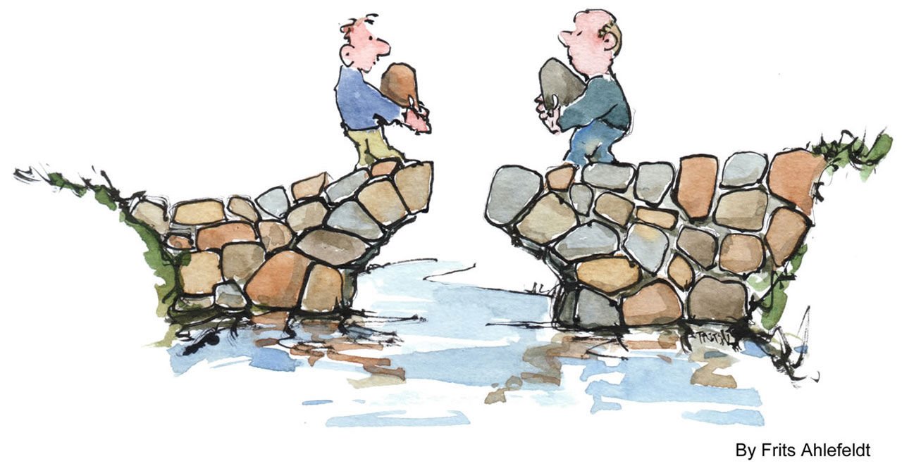
Image, Frits Ahlefeldt
Building Bridges
Notes:
Now this isn’t the best image to use to represent the building of bridges as those structural engineers amongst you will notice that something is sure to collapse very shortly. However bridge building has been fundamental throughout this whole project.
But let me give you some context. I previously mentioned we are in Scotland but some of you are probably wondering where Dundee and Angus actually is.

Slide 3
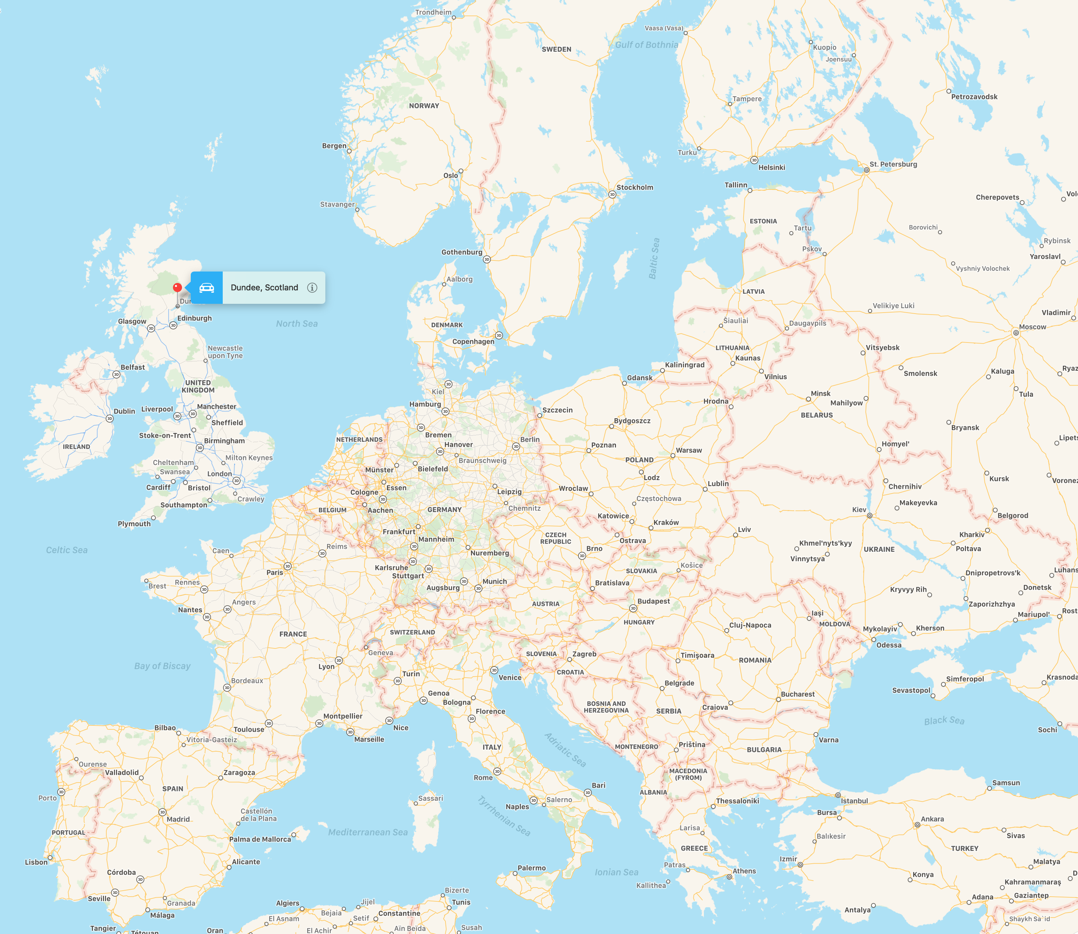
Notes:
This is us. On the east coast of Scotland pretty much right between Aberdeen to the north and Edinburgh to the south.
The college was recently formed from the merger of two other colleges – Dundee College and Angus College – hence, Dundee and Angus!
Dundee is the city – the fourth largest in Scotland and also the sunniest with a population of around 125,000. It was a manufacturing city which no longer is a UK thing so has suffered in recent years. Many students come from disadvantage or deprived areas of the city however the waterfront development is now underway and is a billion euro redevelopment project including the V&A museum of design.
Angus is the county – very rural with just six towns of under 20,000 people. Lots of grain and barley grown for whisky!
We have two campuses in Dundee and one in Arbroath

Slide 4
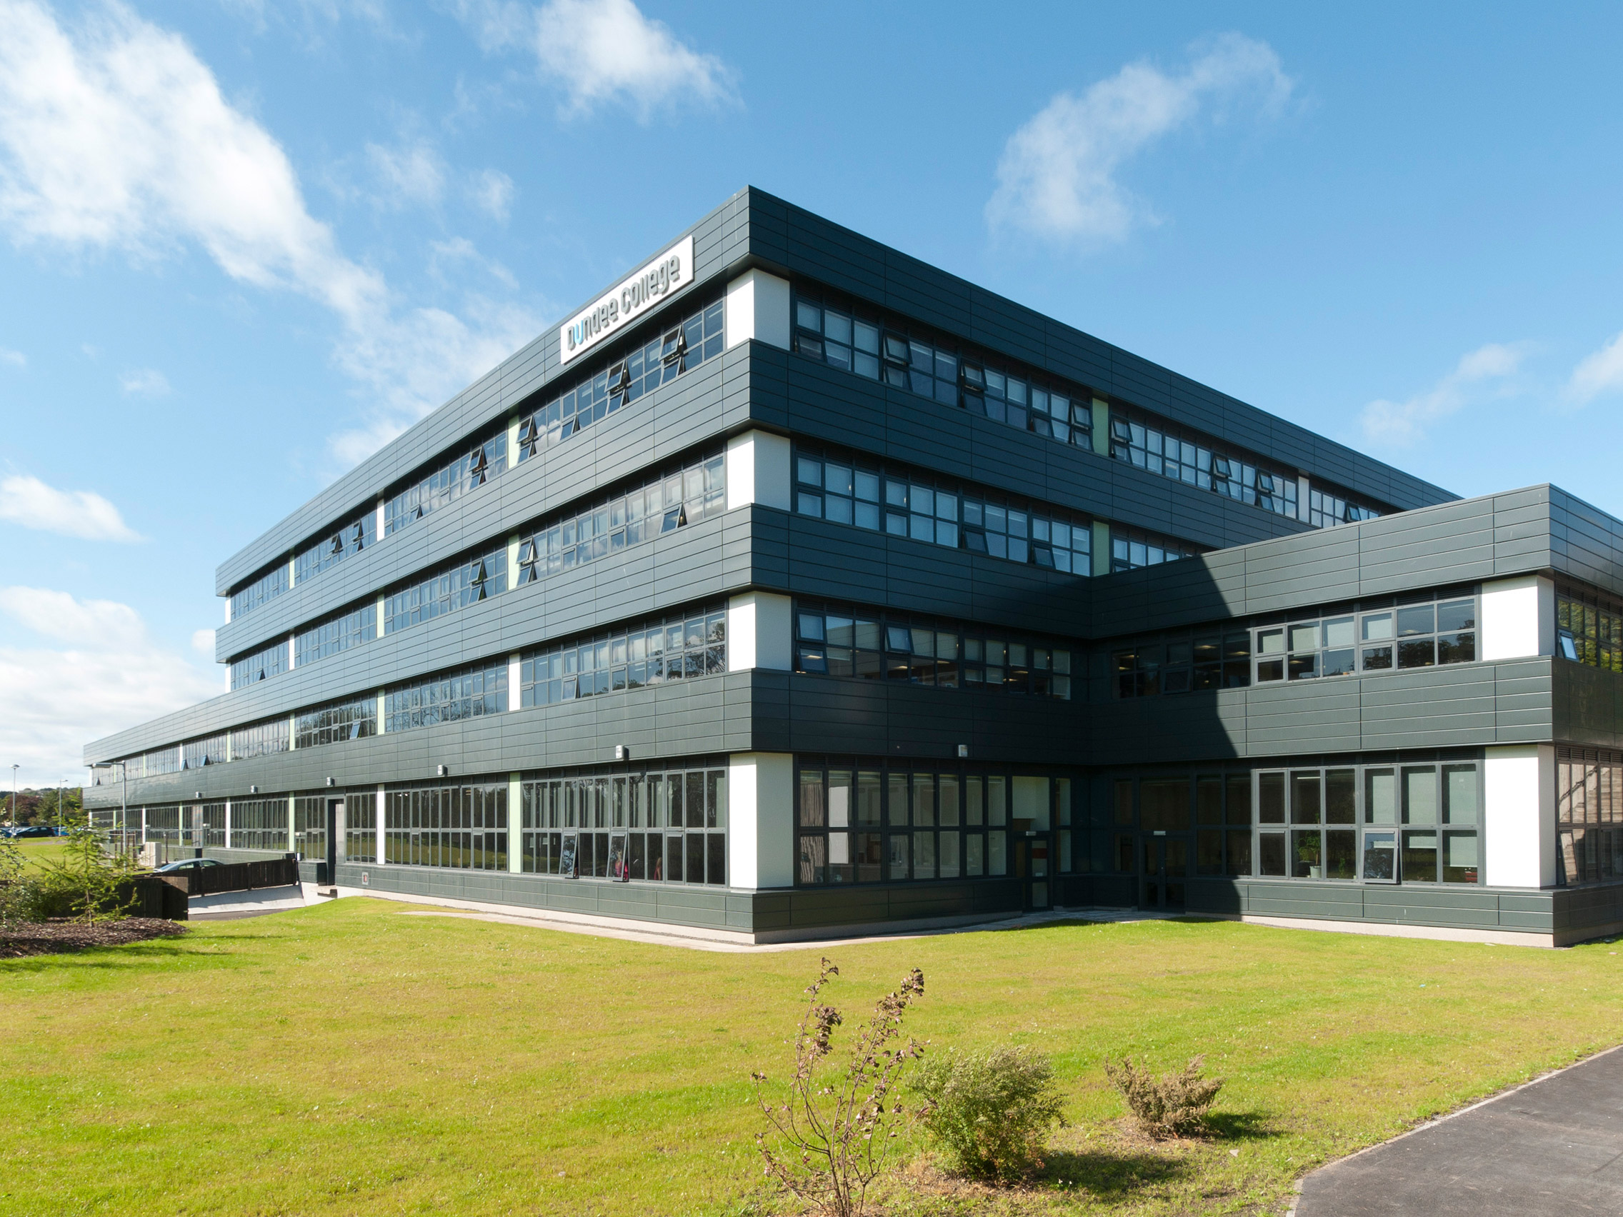
17 secondary schools (11-18)
88 primary schools (5-11)
2000sq km
XXX in sport
250,000 people
1,000 staff
16,000 learners
Notes:
Metrics
16,000 learners
1,000 staff
Over 400 students studying sport aged 16+ on courses ranging from Fitness Instruction through Coaching and Developing sport with articulation routes through to Further Education. SCQF levels 4-7, EQF levels 2-5
Catchment area: urban dundee, rural angus
Over 2000 sq km
Containing 250,000
(works out to 125 people per sq km)
We serve 88 primary schools and 17 secondary schools (11-18)

Slide 5
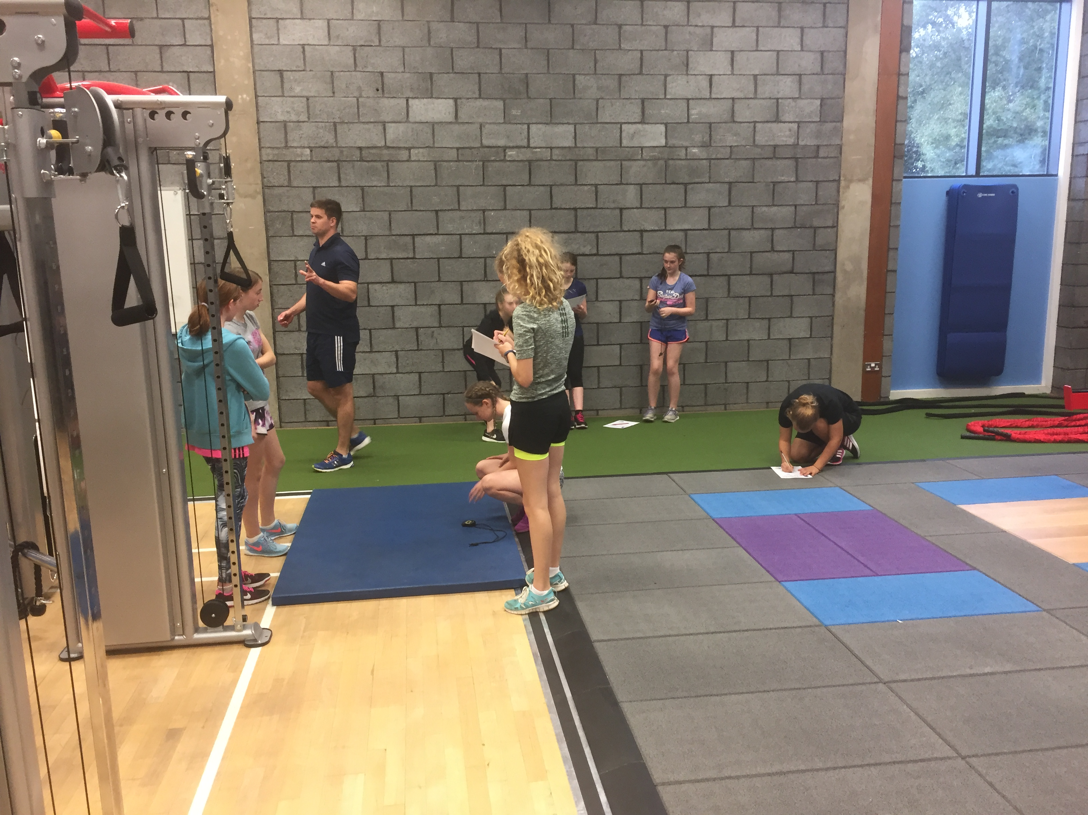
Partnerships
5 local schools
Project partners
Major associate partners
Notes:
Partnerships with local schools; Grove Academy, Morgan Academy, Arbroath Academy, Craigie High, Websters High
Partnerships with key local organisations including Dundee Academy of Sport (engaged with 34968 students in the past three years over 1200 sessions), Active Schools Dundee (XXX students) and Active Schools Angus (XXX students)
Partnerships with new partners and organisations via the project. Expansion of networks and removal of borders via transnational work

Slide 6
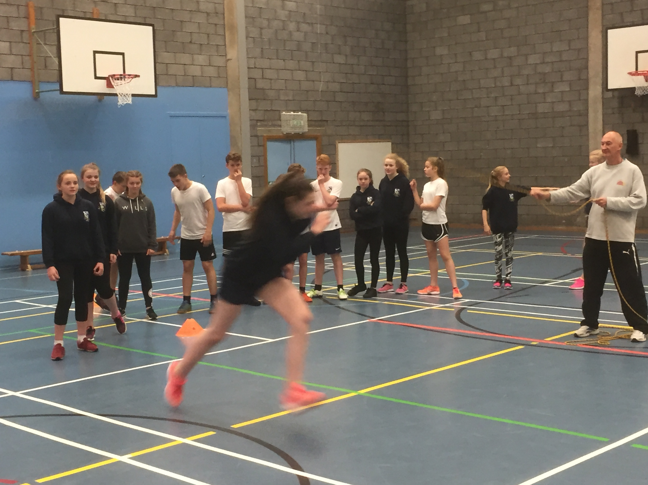
Bridge Building
Curriculum and sport
Academic students and sport
Sport achievers and academic
Minority sports and students
Notes:
Whilst the project has it’s key aims, we found that everything distilled into one element – bridge building
Building bridges between sport and physical exercise and the curriculum. One aspect we look at within D&A is using sport to teach essential skills and vice versa. To give an example, Stephen’s department use sporting examples to teach other areas – take a golf ball, by using a golf ball which is a sporting piece of equipment, we can start students thinking about physics, air resistance, design and innovation. Why does a golf ball have dimples? How did the idea catch on? [Talk about why it does have dimples]
Academics and sport – this isn’t our core area as our students don’t choose sport as an elective, they study sport full time. However our partnerships with schools have brought this into the mix which I will touch on shortly
Sports and academic study – links back to the building of bridges between sport and physical exercise. Getting our sporting achievers to realise that their academic studies are still valid. Our sports courses cover many essential subjects other than sport.
Minority sport

Slide 7
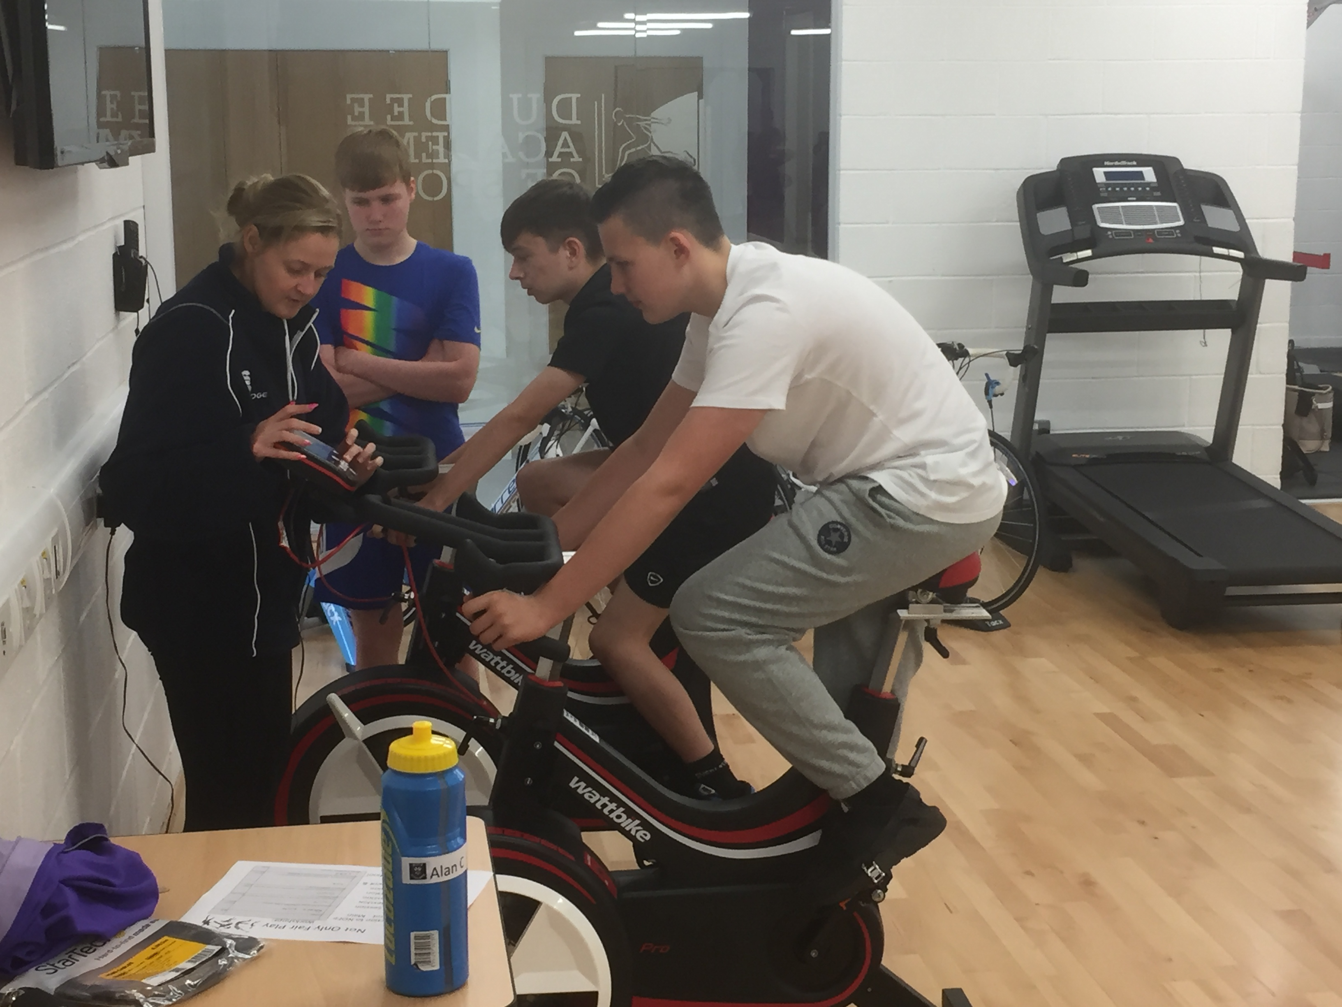
Bridge Building
schools
Notes:
We have engaged with schools more than we previously did in the sports area – the project essentially forced us out – and the reaction we got from some schools was fantastic.
We are working with our school partners to provide senior phase pathways for students aged around 16-18 – taking them temporarily out of school and bringing them into college whilst still at school – delivering employment qualifications in the sporting sector such as NPLQ and Level 2 Gym Instructors – qualifications that improve their employment opportunities.
Building on top of this, we are speaking to schools about other education pathways and providing careers and education advice. All this would have happened for sure, but the Not Only Fair Play project prompted us to engage with schools in this area and brought it about a lot quicker.
It built the bridge!
---
Snr phased delivery – taking students 15+ bringing them into College. Delivering employment qualifications (NPLQ, Lvl2 Gym Instructors)
Spoken to schools about educational pathways, careers and education advice

Slide 8
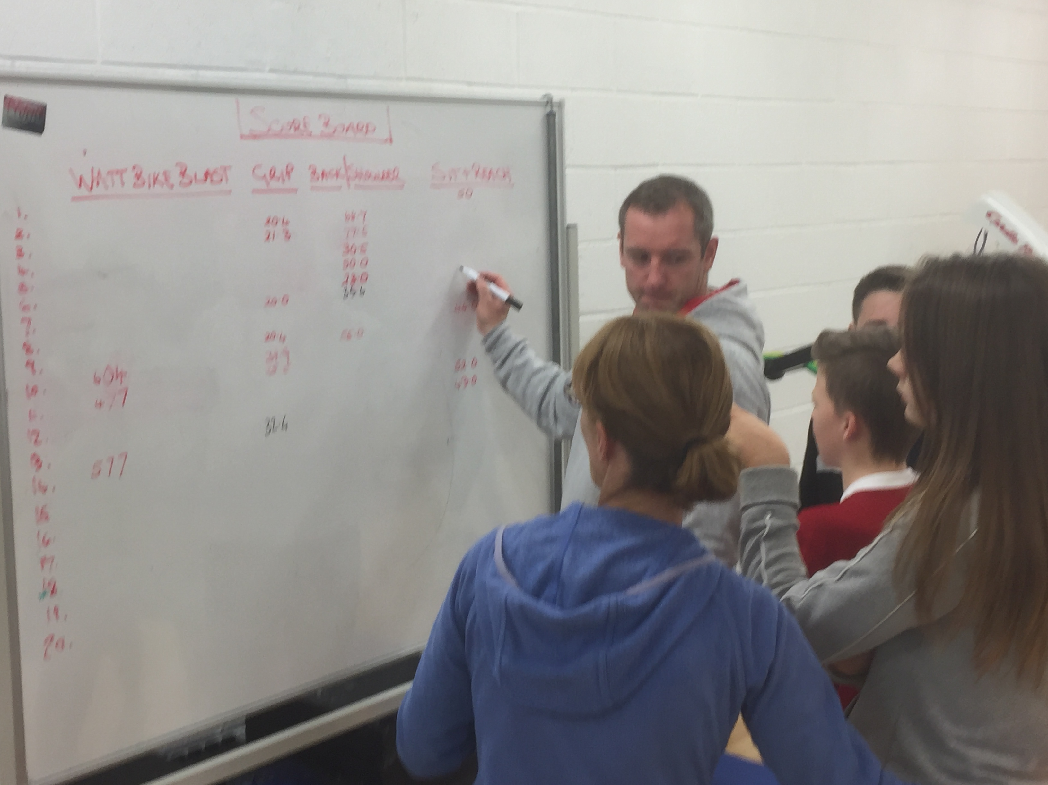

Bridge Building
Associate partners
Notes:
Unfortunately, we haven’t been able to engage with as many associate partners as we would have liked – and Lorenzo would have liked – however our associate partners have brought scale of dissemination to the project.
Dundee Academy of Sport engages with thousands of students across the area.
Active Schools Dundee engage with the majority of local schools in the sports and physical movement area. Likewise Active Schools Angus at the regional level. Just these three partners provide access to virtually every school pupil in our catchment area.
Whilst we engaged with these organizations prior to Not Only Fair Play, the project spurred us on to further than engagement which has led to

Slide 9
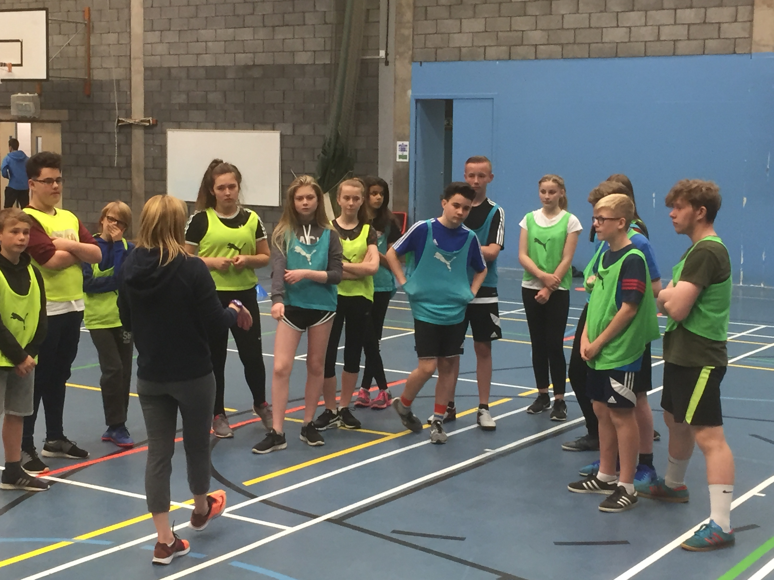
Bridge Building
Project partners
Notes:
One of the hidden benefits of these projects is the people you meet, the expansion of your networks and the future opportunities and possibilities that that network expansion can provide.
Not Only Fair Play has brought together 11 partners from 9 different countries together and we are hopeful we can work with them all again – indeed, we are already finalizing staff and student mobilities under the Erasmus+ programme with one partner – and hopefully there will be a lot more!
When you start these projects you all arrive as strangers with a shared common aim; you leave them as friends with new people who have shared interests and a commonality of making education better – developing our young people in new ways to provide new pathways into further and higher education, to provide them with new opportunities – to leave them in a much better state than when you first meet with them.

Slide 10
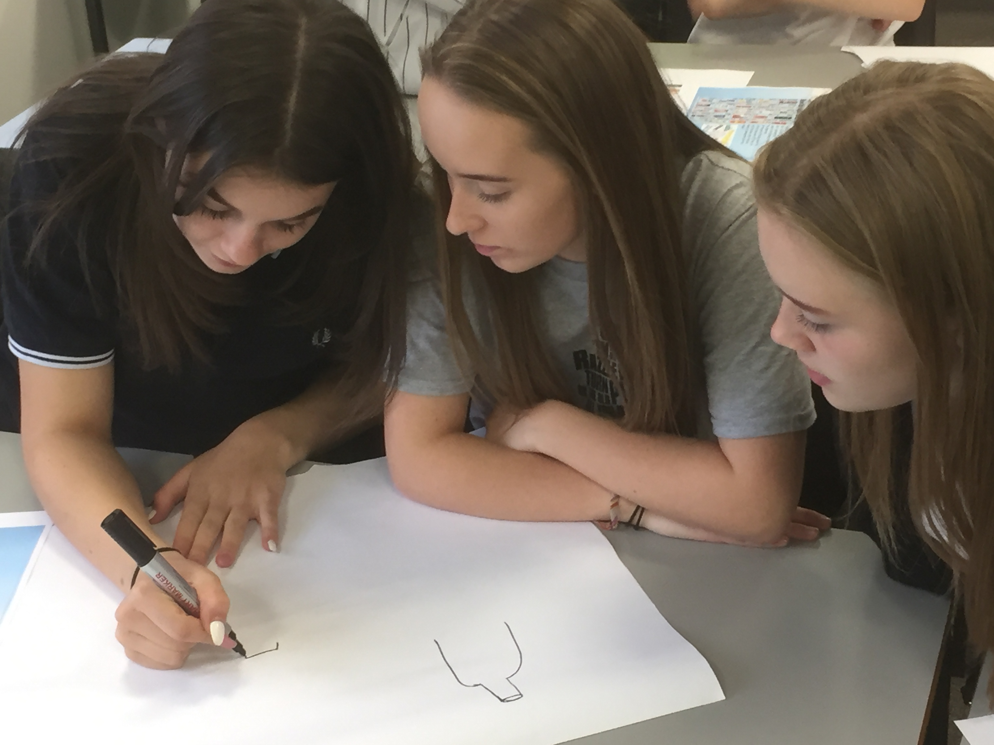
Key Outcomes
Notes:
So to our Key Outcomes. What have Dundee and Angus College benefited from Not Only Fair Play?
well, with our school engagement, we are and have developed new pathways between school and college through senior phase delivery providing employment ready qualifications to 16-18 year olds still in school. This also increases awareness of our provision within the schools and we hope this will lead to more students joining out sports and fitness courses in the near future. This also encompasses the project theme about inspiring sporting achievers to continue with academic studies.
Our sporting event brought together just under 100 pupils for a series of events centred around the project aims, exposing them to new sports, new ideas and new thoughts about potential opportunities. This encompassed the project aim of encouraging minority sport and also the aim of inspiring non-sporting students to take part.
Our network is larger and stronger than before we started
We have a set of toolkits we can push to all schools in the area, not just our partner school
We have a set of guidelines for policymakers to help amend the school sports provision in our country for the better
We have a comprehensive archive of case studies and best practice that all schools can use to generate ideas and amend their own processes to ensure that we provide our school children with the best possible outcomes.
And that after all, is what each and every one of us aims for when we wake up each and every morning.
Purely and simply: To make a positive difference to the lives of our students.

Slide 11
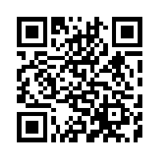
Questions?
l.scragg@dundeeandangus.ac.uk

