Slide 1
Fair Play and Much More Not Only Fair Play Project in Poland

Slide 2
Introduction
Why has the NOFP Project been very important in Poland?
Physical activity is considered one of the most important elements of a healthy lifestyle and determinant of physical and mental people’s health .
The survey conducted by the Ministry of Sport and Tourism in 2015, by means of a standardized International Physical Activity Questionnaire
on a representative sample of Poles over the age of 15 years (approx. 1000 people), indicated that the percentage meeting the criteria of the WHO reg. physical activity undertaken in leisure time is at a level of 15.5%
https://s3-eu-west-1.amazonaws.com/fs.siteor.com/msport/files/badania%20i%20analizy/spo%C5%82eczny%20wymiar/gfk_poziom_af_2015.pdf?1452761993

Slide 3
2. A new reform of educational system in Poland
A new educational reform in Poland will be carried out in stages starting from the school year 2017/2018.
Now: primary school – 6 years, gimnazjum – 3 years, secondary school 3 years, New proposal: primary school – 8 years, secondary school – 4 years.
The number of PE lessons will not change : 6-8 level of primary school – 4 lessons a week, secondary level schools – 3 hours a week

Slide 4
3. The project theme in a context of OKUN mission
CKZiU Nr 1 - OKUN is a teachers’ continuing education institution.
Our main aim is to prepare teachers to improve teachers’ efficiency, ability, knowledge and motivation in their professional work and stimulate personal development.
In the fast changing world education is changing. Many changes are related to economic, social and technology needs.
The teachers’ role is also changing, thus there is a need to meet new demands.
Educators are expected to acquire new competences, improve the quality and efficiency of teaching.
Teachers need support : in service trainings, innovative didactic materials, modern methodology, access to valuable resources and possibility to exchange best practises, experiences and reflections.

Slide 5
Vision of a modern teacher
to facilitate, inspire and motivate students to take an active role in learning, shape a habit of physical activity , help to keep balance between sport and academic
to emphasize overall development – acquiring life skills (general and key competences)
to practise multidisciplinary and practical approach
to give guidance on personal, social or psychological problems (e.g.coping with stress, integration with peers, addictions)
to serve as a role model (moral values like respect, punctuality, honesty etc.)
to communicate effectively with parents, colleagues and external bodies
to use modern technology and find creative and constructive ways to integrate technology into the classes

Slide 6
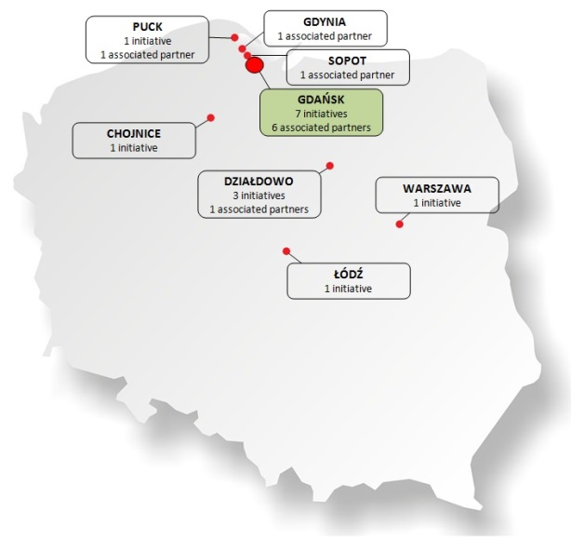
Implementation of the Not Only Fair Play Project
The scope of the direct impact of our activities
- schools, foundations, sport organisations and educational authorities
(best practices providers and
associated partners)
Exploitation - using project materials at schools and during trainings for sport coaches

Slide 7
Schools ( teachers, directors, students, parents)
Constant cooperation with the partner schools, associated schools
Collecting good practices and study cases
Organisation of and participation in family sports festival, workshops, conferences, sport event
Other dissemination activities - information during teacher trainings of related topics in OKUN, on-line information (webpages, mails, on the Epale webpage – Electronic Platform for Adult Learning in Europe https://ec.europa.eu/epale/en/home-page )

Slide 8
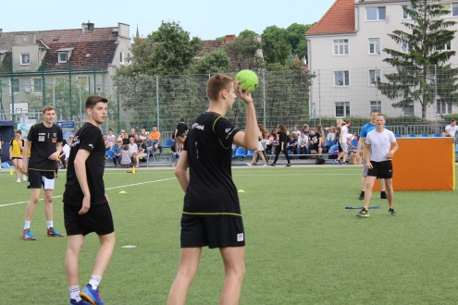
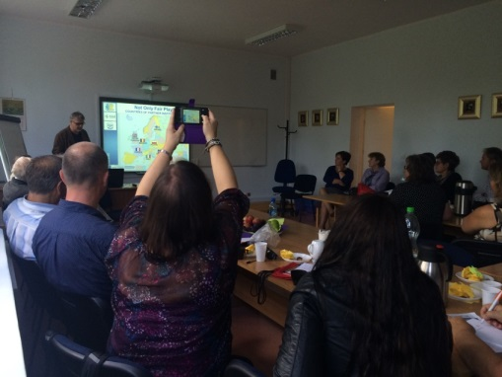
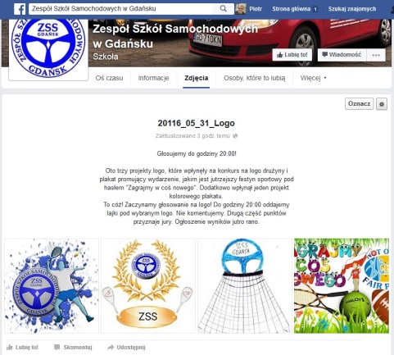
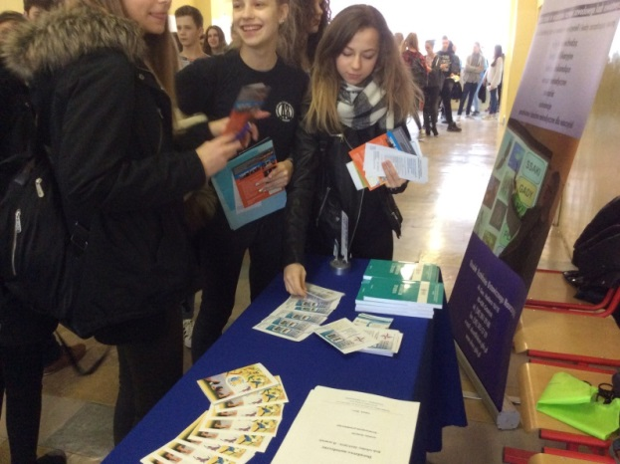
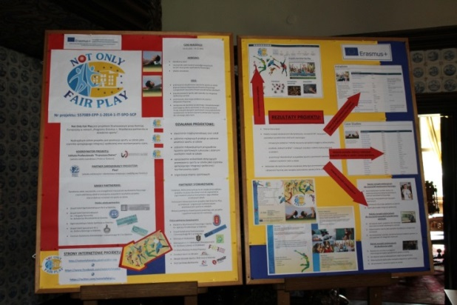
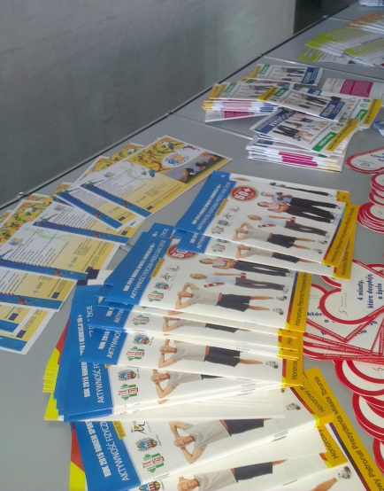
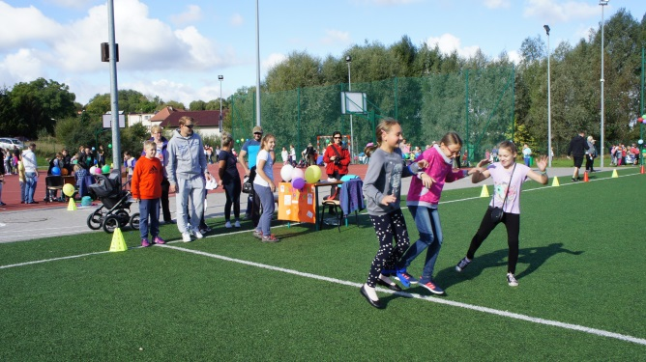

Slide 9
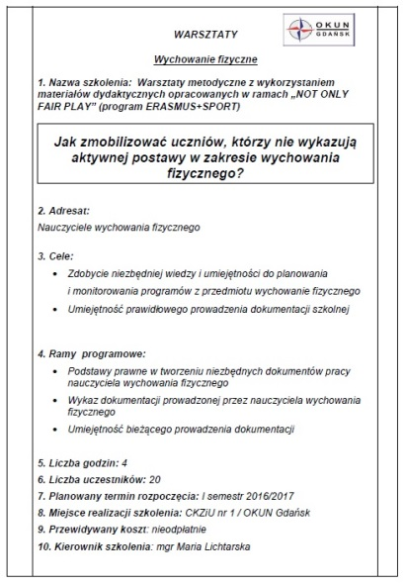
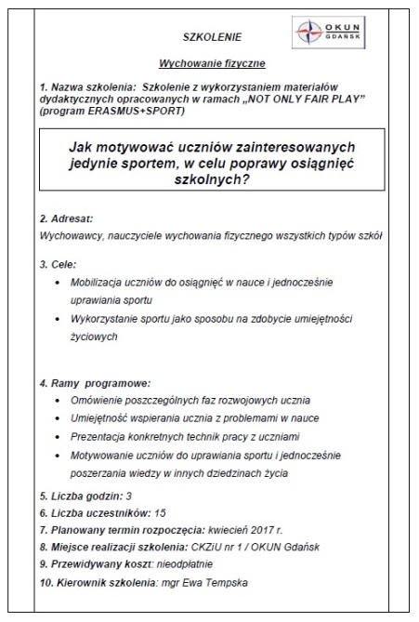
Exploitation – expected results
using project materials in schools – positive teachers’ opinions (comments, testimonials)
new PE teacher trainings inspired and based on the project, conducted by OKUN teachers methodological advisers
How to motivate students who are not usually involved in PE activities?
How to motivate students only interested in sport to improve their school performances?

Slide 10
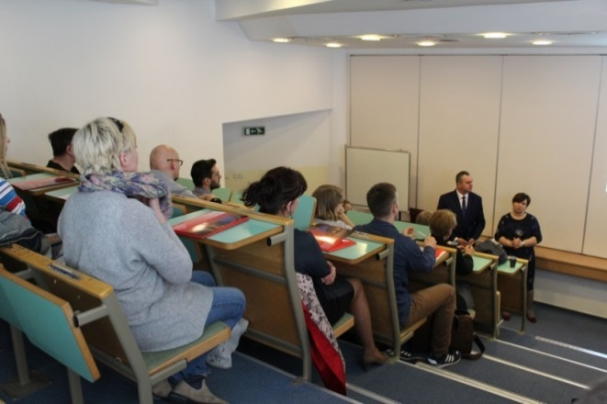
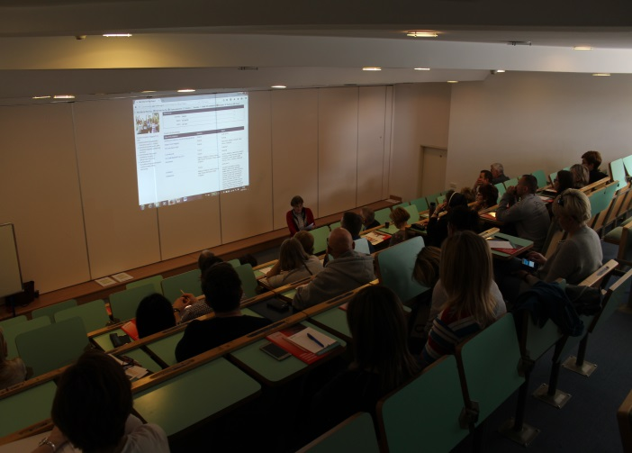
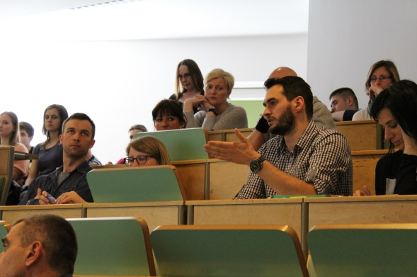
2. academic environment (academic pedagogical staff and students of pedagogical faculties)
Gdańsk University of Physical Education and Sport – conference „How to cope with stress ?” including workshop on NOFP Project
Exploitation - Incorporating of the project materials into academic curriculum for students

Slide 11
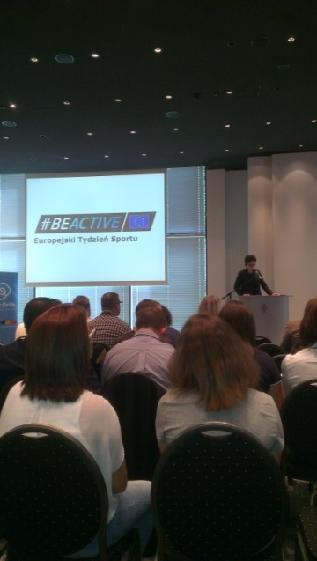
3. Educational and sport authorities (municipal educational authorities, Gdańsk Board of Education, Ministry of Sport and Tourism)
Exploitation – utilizing the Guidelines for Policy Makers:
„Sport and School Education” and „Education for an Ethic Based Sport”

Slide 12
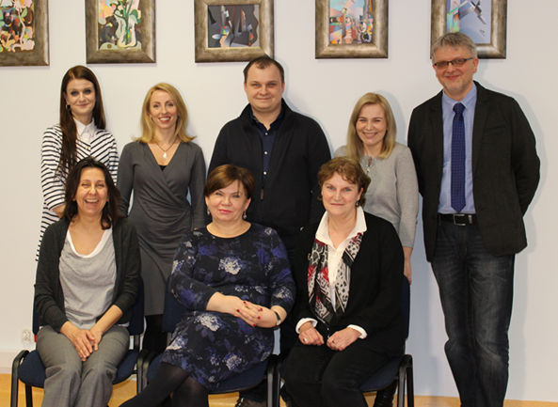
4. OKUN staff – professional and personal development
Elżbieta- director and manager
Piotr – financial issues, IT area
Joanna – coordination
Magda – administrative staff
Łukasz – technical worker
(teachers-methodological advisers)
Alicja, Sylwia, Irena - specialists

Slide 13
Conclusion
Physical activity is an element of our existence that is deeply integrated with all aspects of life. Sport and P A have a significant influence on our health, mental development, helps in building character values and has a significant social value. It contributes to social capacity, social cohesion and social capital.
While implementing the NOFP Project we intended to highlight a multi-dimensional impact of good quality PE in schools and promote sports in a wide context of our institution’s activities e.g. those related to tolerance issue and development of skill connected with managing of stress.
The participation in the Not Only Fair Play Project gave us a great satisfaction to contribute to the valuable international initiative which is very useful for Polish teachers, directors, students, parents, decision makers and all people interested in the topic.
Summing up – our experience and benefit is
Not Only Fair Play – fair play and much more ….

Slide 14
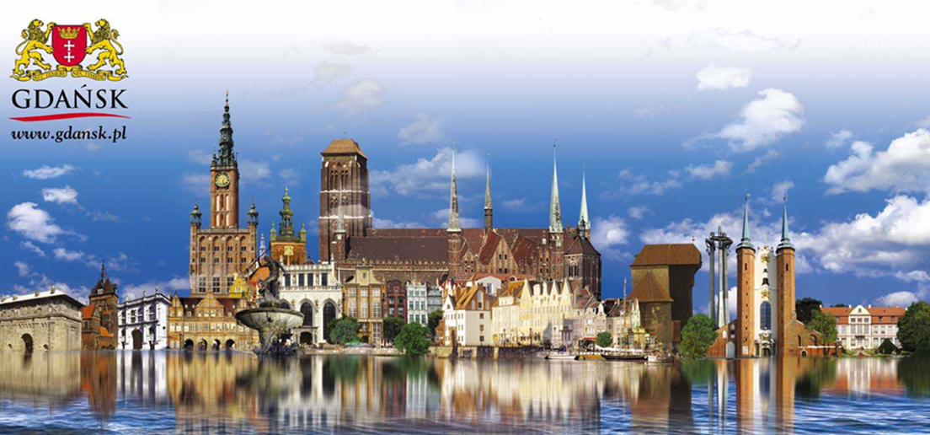
Thank you ☺

